Slide 1
MISSION
With you, making Surrey safer
Central Group Transition

Slide 2
Enforcement the Legal View

Slide 3
Presentation Objectives:
Familiarisation with:
Fire Safety Legislation
Compliance Challenges for the Charity Sector
Primary Authority Scheme
Notes:
Read through

Slide 4
Regulatory Reform (Fire Safety) Order 2005
Notes:
Describe: move from Fire Precautions Act 1971. Onus now on Business.
Describe: Timescales and why (2006 this went live)

Slide 5
General Fire Precautions
Notes:
Article 4 definition.
Describe scalability. Hospice to shop.
Describe general fire precautions.

Slide 6
Responsible Person
The employer, or
The owner, or
The person who has control of the premises in connection with the carrying on of a business, trade or undertaking, or
Notes:
Describe: Who might be RP in their organisation.
Describe: Who potentially are the Fire Authority prosecuting?

Slide 7
Relevant Person
Any person who is or may be lawfully on the premises and/or
Any person in the immediate vicinity of the premises who is at risk from a fire on the premises
Notes:
Describe: who might be legally on their premises.
Discuss: volunteer demographic and associated risks.
Ask: does this include Fire Service?

Slide 8
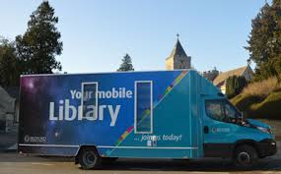
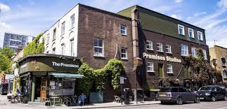
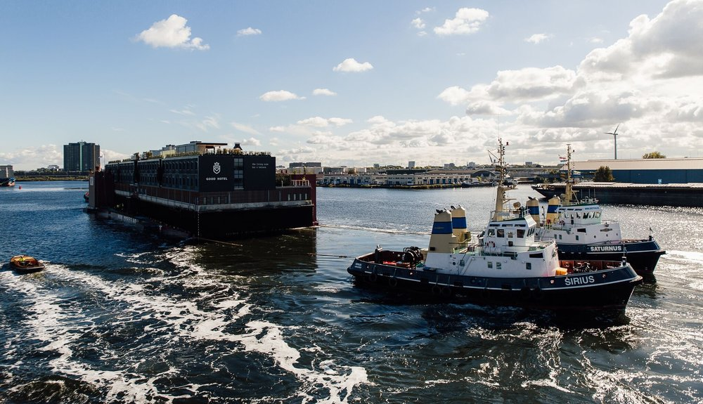
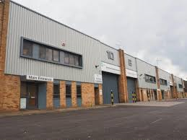
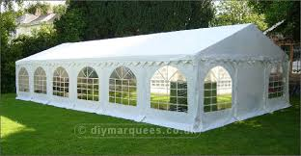
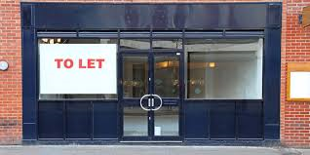
Premises
A Premises is:
Any workplace
Any Vehicle, vessel, aircraft or hovercraft.
Installation on land or foreshore
Any tent or moveable structure
Notes:
Describe Premises portfolio and complexities of managing
Describe Premises exceptions: Article 6

Slide 9
Fire Strategies
Total
Progressive
Simultaneous
Progressive Horizontal
2. Phased
2. Zoned
3. Delayed
4. Stay Put
Notes:
Describe what type of buildings and what required.

Slide 10
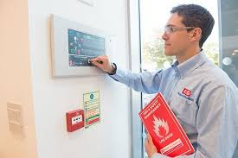
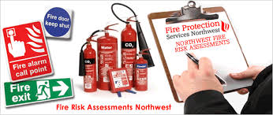
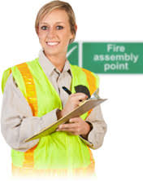
Competent Persons
A person is to be regarded as competent: “where he has sufficient training and experience or knowledge and other qualities”.
1. “To enable him properly to implement the evacuation procedures”.
2. “To enable him properly to assist in undertaking the preventative and protective measures”.
Notes:
Discuss large organisation issues with engaging a competent fire risk assessor.
Discuss issues with snagging of work once completed.

Slide 11
Fire Risk Assessment
“The responsible person MUST make a suitable and sufficient assessment of the risks to which relevant persons are exposed for the purpose of identifying the general fire precautions he needs to take”.
Record significant findings where:
He employs five or more employees
A licence under an enactment is in force
An alterations notice is in force
Notes:
Read through Article 9 –
Explain how underpins legislation.

Slide 12
Other relevant articles
Article 10 - Prevention
Article 11 – Fire Safety Arrangements
Article 13 – Firefighting & Fire Detection
Article 14 – Emergency Routes & Exits
Article 15 – Procedures for Imminent Danger
Article 17 – Maintenance
Article 21 – Training
Article 22 – Co-operation & Co-ordination
Notes:
Discuss what the fire authority are looking for in each article at a premises.

Slide 13
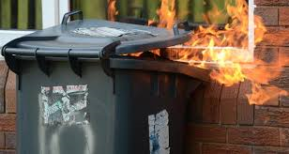
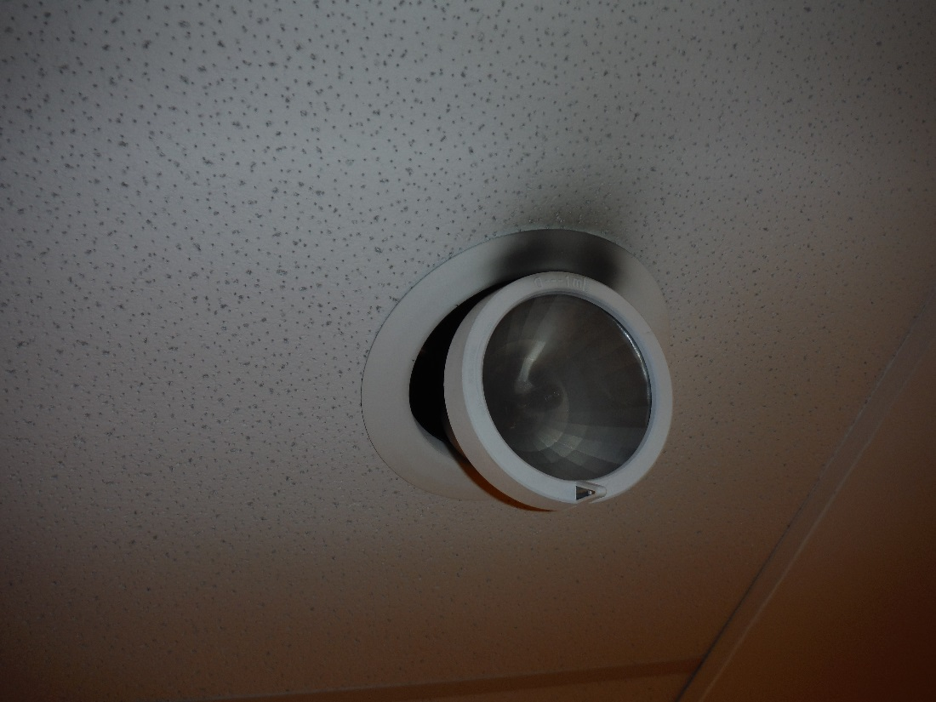
Article 10: Prevention
Notes:
Discuss issues around stock control
Most likely cause of a fire in a shop – Electrical fault

Slide 14
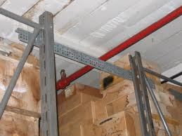
Article 13:
Firefighting & Fire Detection
Notes:
Requirements where sprinklers are installed

Slide 15
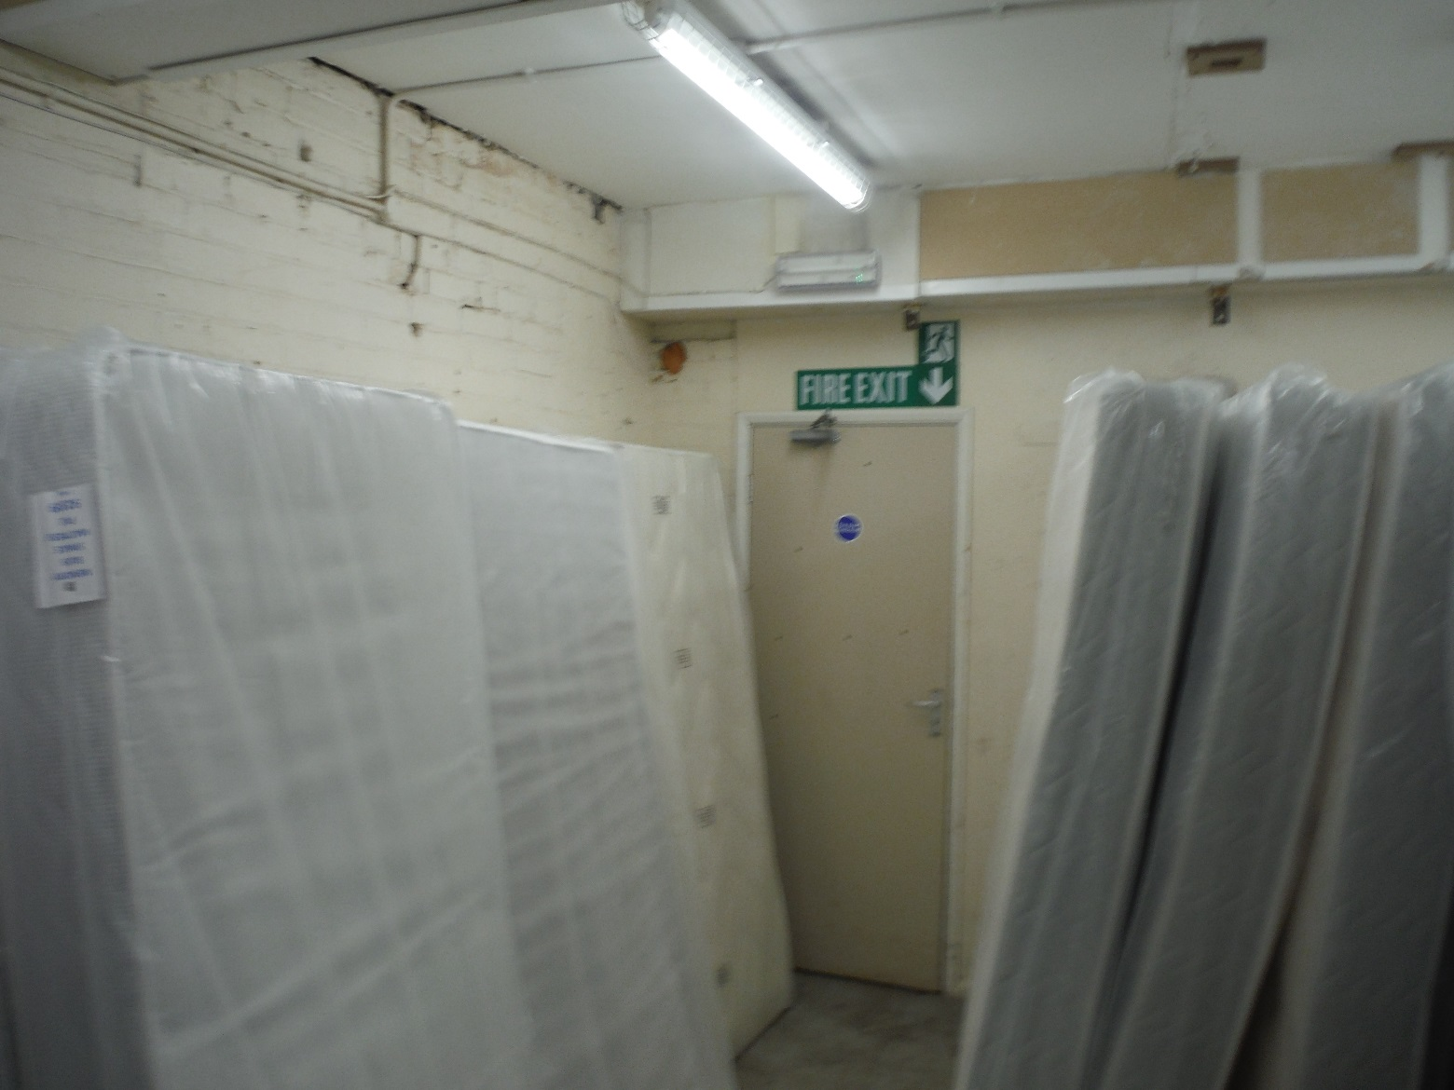
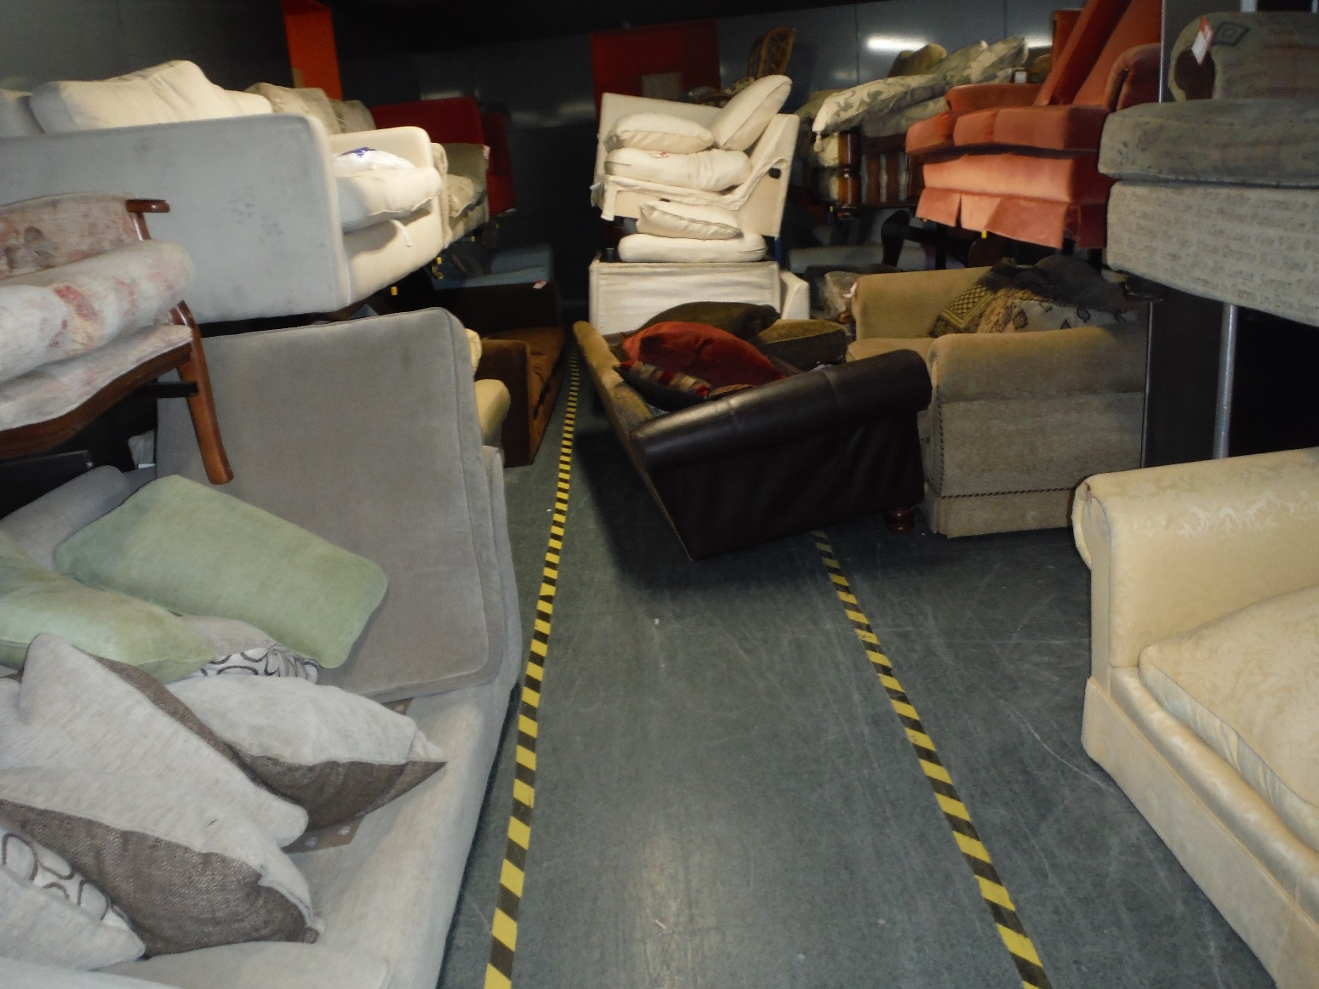
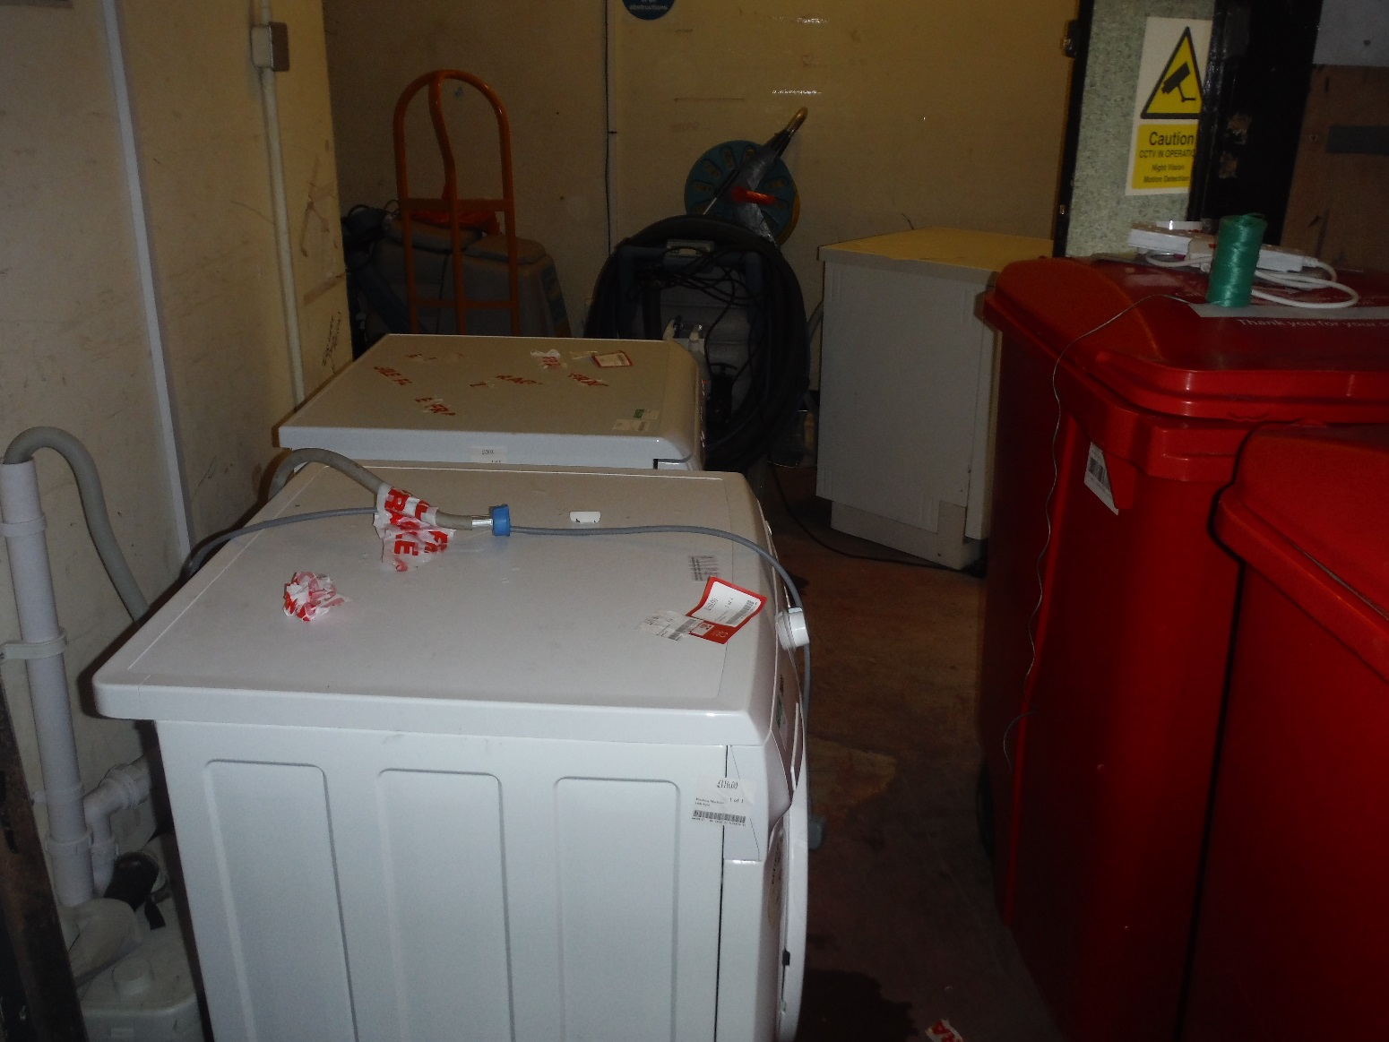
Article 14:
Emergency Routes & Exits
Notes:
Discuss what an officer will expect with a premises.

Slide 16
Primary Authority Scheme
Notes:
Describe the benefits of the PA Scheme.

Slide 17
When an Inspector Calls
Notes:
What to expect on an audit
Enforcement Model
Regulators Code

Slide 18
Surrey Fire and Rescue Service

